Slide 1
Aula Cartografia dos [novos] Meios e Analítica Cultural
Lev Manovich, Mark B. Hansen

Slide 2
Tópicos/Questões orientadoras
O que estes textos/autores/procedimentos fazem na disciplina de Pesquisa em Audiovisual?
Manovich
2.1 – pesquisador, objeto, objetos empíricos, problema, metodologia.
Hansen
3.1 - pesquisador, objeto, objetos empíricos, problema, metodologia.
4. Contribuições específicas sobre o cartografar
5. Hansen criticando Manovich
6. Manovich “2.0” – cultural analytics

Slide 3
Resenha de William Warner sobre LONM (Postmodern Culture, v. 12, n3, maio 2002)
The analysis achieves a lot of its rhetorical force from the consistent operation of what I would like to call Manovich’s analytical engine. By using the word “engine,” I am seeking to isolate the recurrent movements in his analysis. I can demonstrate this analytical engine as it sorts the implications of one of the “operations” discussed on the third chapter: selection.
A análise realiza um monte de sua força retórica da operação consistente do que eu gostaria de chamar a máquina analítica de Manovich. Ao usar a palavra "motor" Estou procurando isolar os movimentos recorrentes em sua análise. Posso demonstrar este motor analítico em como ele classifica as implicações de uma das "operações" discutida no terceiro capítulo: seleção.

Slide 4
TEMA : Seleção
1. Manovich oferta os empíricos
2. Generalização de “abertura”:
  “New media objects are rarely created from scratch; usually they are assembled from ready-made parts. Put differently, in computer culture, authentic creation has been replaced by selection form a menu.
3. Questões arqueológicas situam a seleção dentro de uma longa tradição da cultura visual
4. Manovich faz uma “broad and loose” (ampla e vaga?) conexão cultural:
“The process of art has finally caught up …with the rest of modern society, where everything from objects to people’s identities is assembled from ready-made parts. Whether assembling an outfit, decorating an apartment, choosing dishes from a restaurant menu, or choosing which interest group to join, the modern subject proceeds through life by selecting from numerous menus and catalogs of items.

Slide 5
5. Como, pergunta Manovich, can one resist this rhetoric of endless choice through selection, a obrigação de escolher como forma de expresser sua identidade
6. Manovich clinches the centrality of selection with a new media example: “The WWW takes this process [of selection as more pervasive than invention] to the next level: it encourages the creation of texts that consist entirely of pointers to other texts that are already on the Web.”
7. Manovich makes a detour into the prehistory of cinema: the Magic lantern exhibitor was also a selector. Crucial to this practice in film and video has been the modern standardization of formats. These allow the cutting and pasting that enables selection to work.

Slide 6
8. Manovich makes a cultural connection to art theory (here postmodernism). The technique of pastiche, the quoting of earlier styles, which is widely associated with postmodernism (by Jameson and others in the early 80s) is seen by Manovich as finding its fullest realization with software: ”In my view, this new cultural condition found its perfect reflection in the emerging computer software of the 1980s that privileged selection from ready-made media elements over creating them from scratch.” (131)
9. Manovich makes a conceptual extension of the concept of selection to that of filtering, in new as well as older electronic media
10. This leads to a retroactive interpretation of older media in light of new media: This mutability of electronic media is just one step away from the ‘variability’ of new media.
11. This allows Manovich to assess the difference made by digital mutation: Now we can see that the mutability of signals suggests that radio and tv signals are “already new media.”
Manovich closes his analysis through a witty invocation of a new cultural practice: The rise of the DJ is seen as cultural symptom of the centrality of the art of selection. “The essence of the DJ’s art is the ability to mix selected elements in rich and sophisticated ways…. [T]he practice of live electronic music demonstrates that true art lies in the “mix

Slide 7
Máquina analítica de Manovich desenvolve (produz) um termo ordinário -seleção –para pensar sobre o que é viver em uma cultura da computação ​​. Na sua perspectiva, seleção não vem do software. É algo que os seres humanos-artistas, consumidores e usuários, fazem e tem feito em uma vasta gama de contextos, talvez por tanto tempo quanto a cultura humana.
A discussão de Manovich efetivamente coloca teóricos da estética (...) e artistas em diálogo em torno do tema da seleção. Tal perspectiva sobre 'seleção' incorpora uma discussão sobre o determinismo da mídia que ele nunca explicita: as mídias computáveis (computable media) ​​não determina cultura. Os prazeres da seleção ajudam a impulsionar o aproveitamento de uma tecnologia que amplia os poderes da seleção. Desta forma, as novas mídias são um sintoma da cultura, ao invés de algo que vem de fora dela.

Slide 8
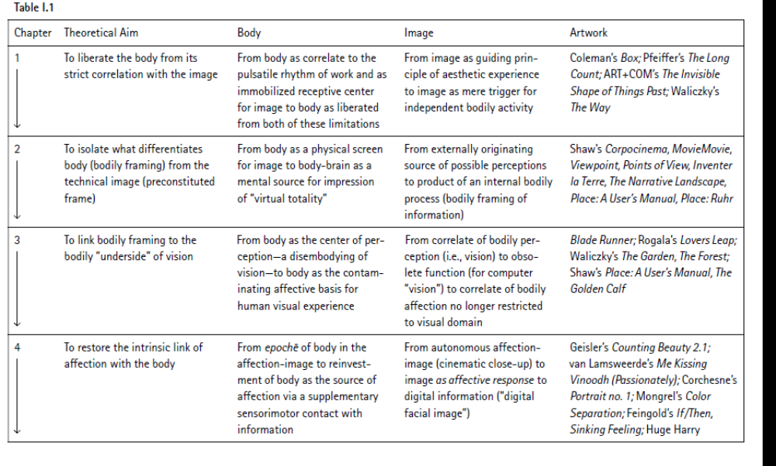

Slide 9
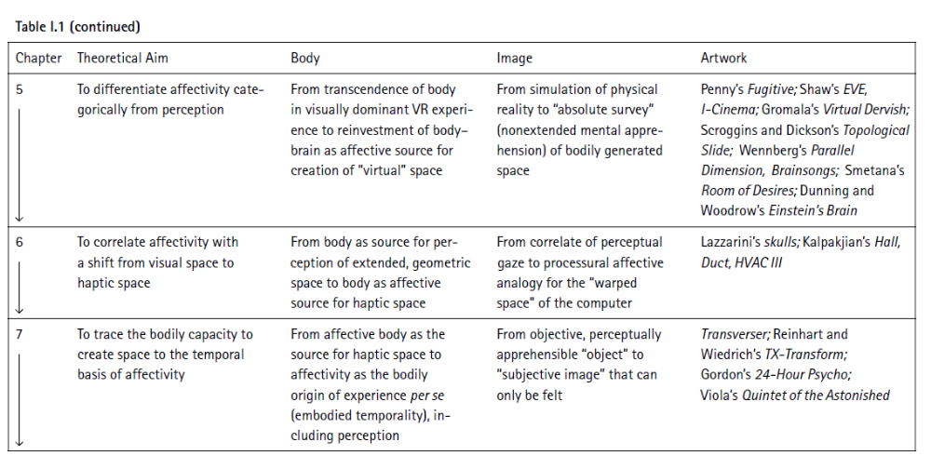

Slide 10
ART+COM – Invisible Shape of things to come
Manovich:
“Em The Shape of Things Past Invisible Joachim Sauter e Dirk Lüsenbrink da Arte com sede em Berlim + Com coletivo criaram um verdadeiro inovador de interface cultural para acessar dados históricos sobre a história de Berlim.
A interface de-virtualiza cinema, por assim dizer, colocando os registros de cinema visão de volta em seu contexto histórico e material. À medida que o usuário navega através de um modelo 3D de Berlim, ele ou ela se depara com formas alongadas deitado ruas da cidade. Essas formas, que os autores chamam de "filmobjects", correspondem a Documentário gravado nos pontos correspondentes na cidade. para criar cada forma a filmagem original é digitalizado e os quadros são empilhados um apósoutro em profundidade, com os parâmetros originais da câmera que determinam a exata forma. O usuário pode visualizar as imagens clicando no primeiro quadro. Conforme os quadrossão exibidas uma após a outra, a forma está ficando proporcionalmente mais fino.

Slide 11
(continuação análise Manovich)
“The records of camera's vision become material objects,sharing the space with the material reality which gave rise to this vision. Cinema
is solidified. This project, than, can be also understood as a virtual monument tocinema. The (virtual) shapes situated around the (virtual) city, remind us about the era when cinema was the defining form of cultural expression — as opposed to a toolbox for data retrieval and use, as it is becoming today in a computer.

Slide 12
Crítica de Hansen a Manovich nessa análise
What is missing from Manovich’s exposition of these works is any account of the significant role accorded the body as the “operator” of an alternative, post-cinematic interface with data.
For this reason, it is striking to see Manovich simply extend the cine matic convention of immobility to these works, in explicit contravention ofhis own call for an “info-aesthetics” that would foreground the movement of the viewer and the role of touch.57 What this shows, I would suggest, is just how much Manovich’s hands seem to be tied by his own argument concerning the cinematic interface.

Slide 13
Cultural Analytics
“Cultural Analytics is the use of computational and visualization methods for the analysis of massive cultural data sets and flows.
Digitization of large sets of cultural artifacts from the past and the rize of social media in 2000s open new possibilities for the study of cultural processes. We can create more comprehensive and inclusive understanding of human cultural evolution and dynamics using all available digitized and born-digital cultural artifacts in any media from all of human history. We can map changing cultural patterns around the world in real time using all available web data (social media, blogs, creators web sites, etc. Reaching these goals will require not ony solving many technical problems but also developing new methodologies and concepts for data-driven cultural analysis.”

Slide 14
Questões de pequisa – Cultural Analytics
- How do we explore patterns in massive visual collections which may contain billions of images and video?
- How do we research interactive media processes and experiences (evolution of web design, playing a video game, etc.)?
- What theoretical concepts and models do we need to deal with the new scale of born-digital culture?
- How can we combine computational techniques and analysis of massive cultural data with more traditional humanities methodologies?
- what would "science of culture" driven by massive data look like, and what will be its limitations?

